Slide 1
MOTION DETECTION AND TRACKING USING OPENCV
by
A.vigneswari
reg no: 37110837
guide name: mrs.m.d anto praveena

Slide 2
Computer vision
Computer vision is a form of artificial intelligence .
Which can see the environment and understand and analyse like human.
It seeks to automate tasks that the human visual system can do.

Slide 3
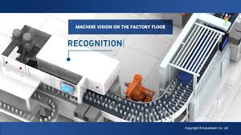
Application
Machine vision
It is the technology which provides automatic inspection and analysis can detect the fault accurately.

Slide 4
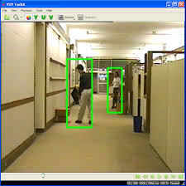
Object Detection And Tracking
It can identify the objects by like human, building and cars by their color,shape as well as motion and can detect and track it.

Slide 5
Application
Human –computer interaction Devices
Autonomous Navigation
Facial Recognition
Motion Tracking
Optical Character Recognition
Image Restoration

Slide 6
Computer vision Pipeline
Image Acquisition
Image
processing
Decision making
Image
Analysis

Slide 7
I implemented one of the applicataions of computer vision
Motion Detection And Tracking on a Video

Slide 8
Objective:
This technique is to detect motion of an object (human) and tracking by drawing rectangle bounding on it.
location of an particular region in x and y axis can be found.
Then particular scene in a video can be saved as a image.

Slide 9
Tools used
My project is build using
Opencv
Python
Some packages
cv2
Numpy
matplotlib

Slide 10
opencv
Stands for ‘open source computer vision’
Library of function for real-time computer vision
Developed in c++
Supports python,java,MATLAB,OCTAVE

Slide 11
Input:
Video file name or the path of the file in which we want to detect motion and track it.
Output:
Video with bounding rectangle on the moving object it may be a human or some other object.

Slide 12
Steps Involved
Extracting the video from file by giving the video filename or the path as a input.
Read two frame sequentially and find the absolute difference between two frame by using difference we can find motion.

Slide 13
Then apply the processing technique like converting the frame into gray and apply blur ,threshold method to remove noises and to get clear view.
Then we can find the contour area by using the method findContours() then the rectangle method is used to draw rectangle bounding on moving object.

Slide 14
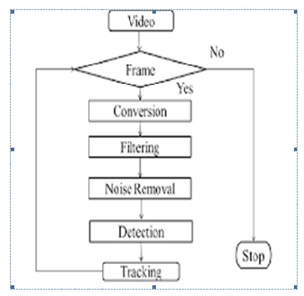
FLOWCHART FOR TRACKING

Slide 15
After Execution
After running the program video will play with rectangle bounding on the moving objects. Thus by we can track the motion of an object.

Slide 16
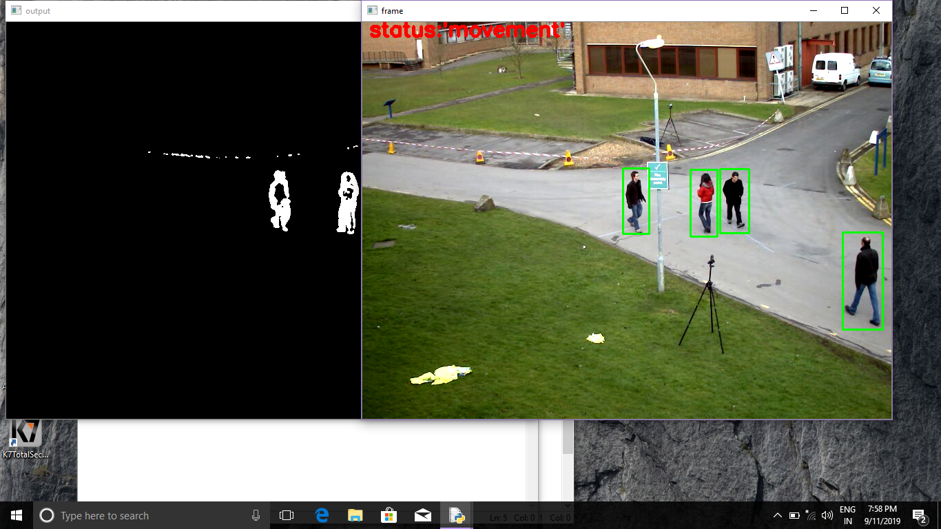
Motion Detected And Tracked

Slide 17
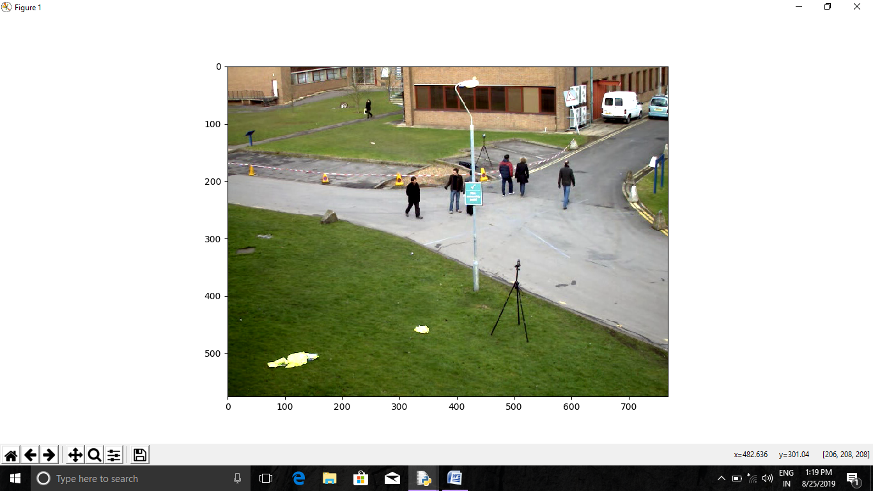
While playing the scene can be viewed as a plotted image by using key function esc.

Slide 18
From the plotted image we can find the location of an particular region by moving curser on the required region.

Slide 19
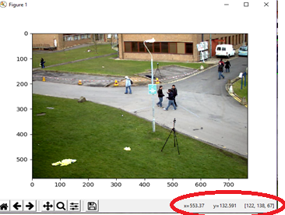
Location Found

Slide 20
Even a scene from a video can be saved as a image by using key function q, by using the inbuilt function in 2D plotting.later which can be used.

Slide 21
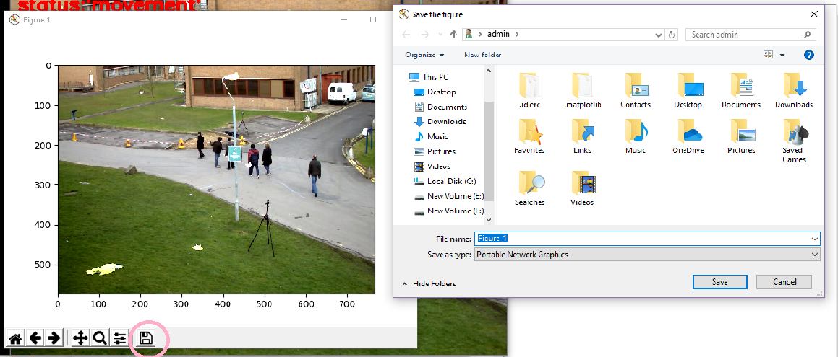
Saving Image

Slide 22
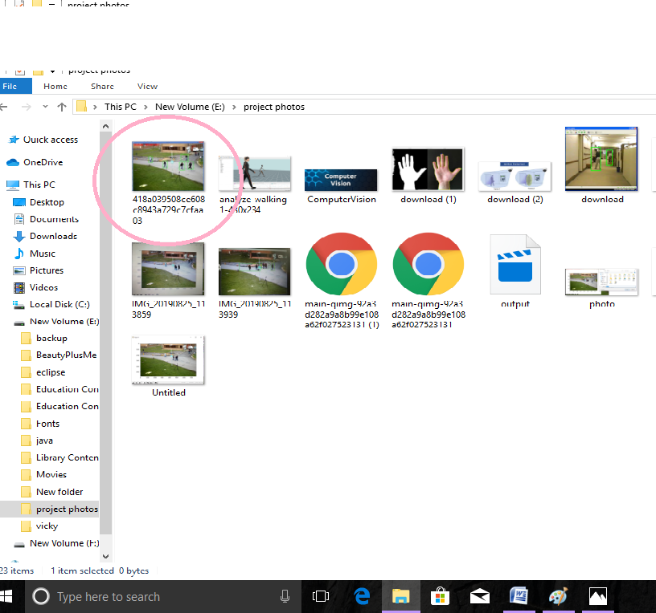
Image Saved

Slide 23
Conclusion
This process is simpler and faster way.
It has high accuracy.
This technology enhances safety.

Slide 24
References
PYTHON : http://www.imarticus.org
COMPUTER VISION http://www.realpython.com
MOTION DETECTION http://www.pyimagesearch.com
COMPUTER VISION A modern approach:Forsyth and ponce,pearson

Slide 25
My sincere thanks to the guide Mrs. M.D Antopraveena and to the head of the department.

